Slide 1
Applying principles of andragogy to college teaching
September 7, 2022

Slide 2
agenda
Key theories of andragogy:
Knowles
Kolb
3 other key theories – Vygotsky & others
Application integration
Application in your course

Slide 3
Andragogy
Notes:
The art and science of teaching adults – Malcolm Knowles
Why use andragogy?
They work on many of our students
Our students need to think more like adults. Many have been spoon-fed all their lives. Need skills at making decisions, problem solving, owning their learning. If we treat them as adults, develop their skills, they grow into it.
support self-efficacy, decision-making, meaningfulness and critical thinking skills.

Slide 4
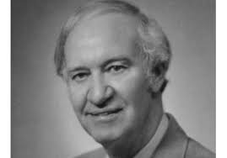
malcolm knowles
Notes:
Father of andragogy. Popularized the study – giant in field. (Term was coined in 1830’s, but he elevated it.)
Studied adult learning –from both informal (YMCA, unions, forums, clubs) and formal continuing education (e.g., cc’s).

Slide 5
Key Theories - Knowles
Assumptions
Principles
Involved in planning & evaluation
Experience drives learning
Immediate relevance of content
Problem-centered vs. content centered
Notes:
Assumptions – can argue with them. Certainly not always true; idealized people. But irrelevant to us.
Self-concept: As a person matures his self concept moves from one of being a dependent personality toward one of being a self-directed human being
Experience: As a person matures he accumulates a growing reservoir of experience that becomes an increasing resource for learning.
Readiness to learn. As a person matures his readiness to learn becomes oriented increasingly to the developmental tasks of his social roles.
Orientation to learning. As a person matures his time perspective changes from one of postponed application of knowledge to immediacy of application, and accordingly his orientation toward learning shifts from one of subject-centeredness to one of problem centredness.)
Motivation to learn: As a person matures the motivation to learn is internal (Knowles 1984:12).
Principles of Andragogy:
Self-direction is important; adults are less likely to learn under direction without understanding why.
Adults need to be involved in the planning and evaluation of their instruction.
Experience (including mistakes) provides the basis for learning activities. Adults need to fit learning into their prior experiences, and add new ones.
Adults are most interested in learning subjects that have immediate relevance to their job or personal life.
Adults need to know why they need to learn something, and they learn best when the topic is of immediate value
Adult learning is problem-centered rather than content-oriented. (Kearsley, 2010). Adults approach learning as problem-solving.
Learning by solving problems.

Slide 6
Application - knowles
Involvement
They design or select activity, topics, options – provide options for different skill levels
They create / modify rubric
They design quiz questions
Self evaluation
Experience drives learning
Ground topic in experience
Compare/contrast experiences
Notes:
Different ways of engaging
Ground topic: Describe a time when you… A situation you have seen…
To define intelligence: Who is the smartest person you know? The least smart? Why, what makes them smart?
- Consider different experiences; mine is not the sum and substance. What does it all mean, together?
Instructors adopt a role of facilitator or resource rather than lecturer or grader.

Slide 7
Application - knowles
Immediate relevance of content
Ask or survey about experience – past or future, personal or career.
Role play – you are an intern…
Plan use / transfer
Problem-centered vs. content centered
Provide a reason to learn (e.g., programming)
Cases, scenarios, simulations, failure examples, work tools, websites, group projects
Notes:
Example of teaching computers:
You need to explain the reasons specific things are being taught (e.g., certain commands, functions, operations, etc.)
Instruction should be task-oriented instead of promoting memorization -- learning activities should be in the context of common tasks to be performed
Instruction should take into account the wide range of different backgrounds of learners;
learning materials and activities should allow for different levels/types of previous experience with computers.
instruction should allow learners to discover things and knowledge for themselves without depending on people.
However, learners should be offered guidance and help when mistakes are made.

Slide 8
Course Application - knowles
ID a concept, skill or process your students struggle with mastering.
Pick one of these principles to adopt
Notes:
NOTE: Need trusting environment.
Need to be able to fail, and analyze failure, and learn from it.

Slide 9
David kolb

Slide 10
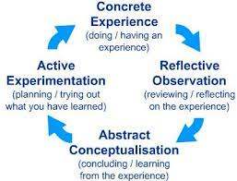
Key theories - KOLB
Notes:
Experiential learning is a process –
Expeience - This may be a new experience or situation, or a reinterpretation of existing experience in the light of new concepts.
Requires reflection and observation to learn most deeply- Particularly important are any inconsistencies between experience and understanding. Mistakes generate learning.
Conceptualize what you learned - reflection gives rise to a new idea, or a modification of an existing abstract concept (the person has learned from their experience). Involves analysis and generalization.
Plan or actually carry out next step. The learner applies their idea(s) to the worl around them to see what happens. (Even in terms of final exam. Write it down. What will you do…?)
JUST DOING THE EXPERIENCE ISN’T ENOUGH
(vs. Knowles – adults are self driven, need to pick their own experience, little guidance.)
Different ways of learning, too.

Slide 11
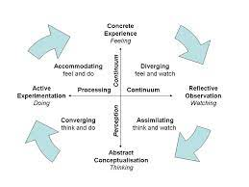
Key theories - KOLB
Notes:
People have different ways of learning.
Diverging – feeling and watching
Assimilating – thinking and watching
Converging – thinking and doing
Accommodating – feeling and doing
I personally think this particular model is a not valid, but there are many other models of “learners have different ways of learning/knowing” (Gardner).
Let students approach the learning in different ways.
Take them through different steps; they may not learn through abstraction (assimilation) the way most academics do.

Slide 12
Application - kolb
After the experience…
Reflect/observe – describe what happened. What worked/didn’t work?
Self assessment.
Share / pool knowledge
Abstract – What did we learn? Why did it happen? Analyze causes.
Plan future application – in career; in life
Predict what will be on exam
Notes:
Let students approach the learning in different ways. Enter at different points – planning application, etc.
Keeping and transferring knowledge is hard.
Kolb’s model will help them do that.
Reflecting/observing
Abstracting
Plan or try out learning in future.

Slide 13
Course Application - kolb
ID an experience your students have where they don’t master or retain what you want
Adopt some of the techniques from Kolb’s steps
Notes:
Keeping and transferring knowledge is hard.
Kolb’s model will help them do that.
Reflecting/observing
Abstracting
Plan or try out learning in future.

Slide 14
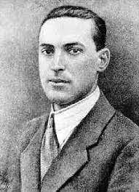
Lev vygotsky
Notes:
Founder of social constructivism – people jointly, through discussion and interaction, construct knowledge and skills. Can’t do it alone.
Focused on children, but began many ideas that were applied to adults.

Slide 15
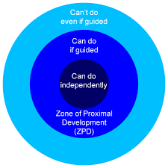
Key theories - vygotsky
Notes:
Zone of Proximal Development – ZPD.
Definition: the distance between the actual development level as determined through independent problem solving and the level of potential development as determined through problem solving under adult guidance or in collaboration with more capable peers
Get students to where they can learn the topic, skill, process with guidance.

Slide 16
Application - zpd
If below ZPD: break into chunks or steps
Assign problem-solving tasks
Use groups – have them help one another
Survey students about skills/knowledge
Self-assessment of skills/knowledge
Assign early task to gauge their skills
x
Notes:
If they can do it independently, why are you assigning it?

Slide 17
Key theories – Vygotsky, others
Notes:
Scaffolding –
Essentially, it’s moving people along from beginners to advanced, step by step. Break complex topics or skills down into constituent pieces, and practice/learn in stages.
The metaphor is fabulous, but has taken over the original meaning (Wood, Bruner, and Ross (1976 ), …
Originally, it meant 1-on-1 tutoring or work with more advanced peer.
Bridging the learner’s current abilities and the target task. As the paper unfolds further, it provides us with the analysis of gradual transfer of initiative, decrease of the provided help and encouragement of responsibility during the scaffolding process (cf. with transfer of responsibility and fading of scaffolding
A functional system that emerges between a child and an adult, as they both iteratively and contingently adapt to each other while solving a particular learning task.
A temporary adaptive support that forms a functional system with the learner, where teacher and learner adapt to one another.
Key elements:
Recruit of the learner to focus on the topic,
Reduce the degrees of freedom: simplifying the task by reducing the number of constituent acts required to reach solution.
Maintain focus and actions until the entire process is learned
Mark or ID critical features (feedback for improvement.)
Help control frustration, and when it does happen, help guide them through it.
Demonstration or modeling
Now, meaning has broadened –
- Help learner or provide those elements of the task that are beyond the learner’s capacity, thus permitting him to concentrate upon and complete only those elements that are within his range of competence”,
- Break the learning into manageable steps or tasks. Move the supports as needed.

Slide 18
Application - scaffolding
Provide cues, clues, elaborations, clarification, suggestions, reminders
Provide prompts, questions, probes, requests, redirection
Provide simplified solutions
Provide emotional support, encouragement
Provide role modeling
Focus attention
Encourage self-monitoring, reflection
Remove supports over time
Notes:
If they can do it independently, why are you assigning it?

Slide 19
Application – scaffolding p. 2
Break complex tasks into pieces, provide feedback on each step (e.g., research paper: topic; question; article summaries; outline; sections of paper)
Peer feedback building to instructor feedback
Pacing / process should be flexible, individualized
Notes:
Data analysis:
Start with MC assessment of facts
Go to simple applications, SA answers, small group applications of mini-cases
Go to failure analysis
Go to complex analysis
Go to unstructured complex analysis, where they make many choices (e.g., data set, type of analysis to use, question to answer.)

Slide 20
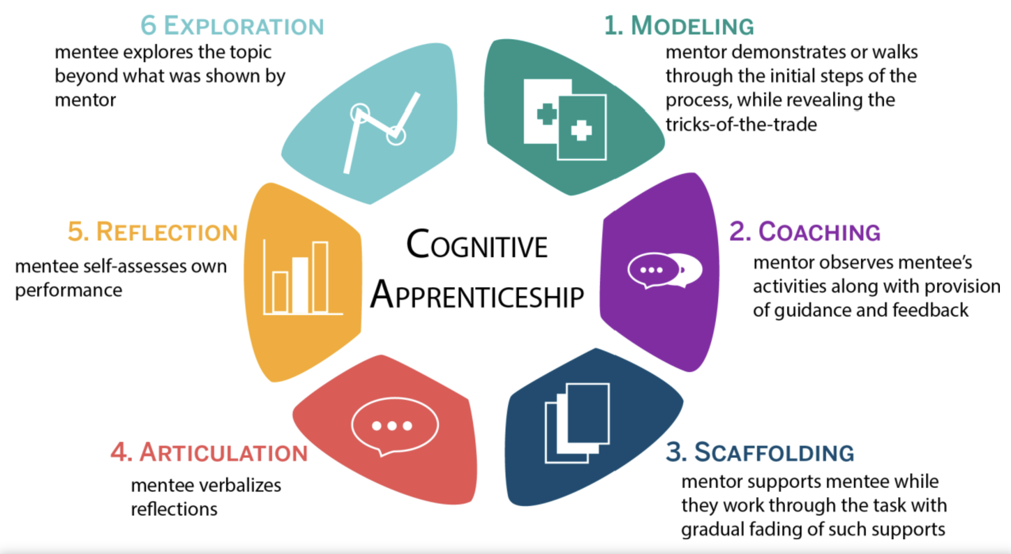
Key theories – Vygotsky, bandura
Notes:
Cognitive Apprenticeship – comes from social constructivism…
Ideas from Vygotsky, Theory of modeling (Bandura). Model from Collins, Brown, and Newman (1989(
Teach cognitive skills by modeling – but because they are cognitive, the teacher has to break down the skills and describe them as they do them. Carry out a cognitive task, describing what they are doing and why.
Think teaching statistics, math.
Makes tacit knowledge explicit.
Start with simpler, go to more complex.
Then direct students to do the same. Observe, give feedback, guide. Give reminders, hints.
“Scaffolding” here = help them, do pieces for them, support them.
Then meta-analysis. Make them conscious and aware, to develop mastery
Have students describe what they are doing
Reflection – have students assess how they are doing. (Compare to expert) Develop internal model of expertise.
Then student explores, tries skills in another context. This supports transfer.
Ideally, approach or describe the problem in a realistic situation like where they will use it. (“Situated learning.” Context of cognitive skills is important.
Some sort of problem solving – big problem broken up into smaller ones.
Make it cooperative – a social experience, where feasible.
Art is taught this way. Also statistics, math, economics. Other skills, like reading/writing!
Can be used to teach the following types of Content, which includes concrete facts and ideas as well as problem-solving skills:
Dimension knowledge: Specific concepts, facts, and procedures
Heuristic strategies: Generally applicable techniques to accomplish tasks (“rules of thumb”)
Control strategies: General approaches for directing one’s solution process
Learning strategies: Knowledge about how to learn new concepts, facts, and procedures

Slide 21
Application – cognitive apprenticeship
Break complex task into smaller chunk
House in realistic situation
More experienced people give guidance, hints, reminders, coaching
Paired feedback, small group feedback
Post-activity description of action, outcome and self-evaluation

Slide 22
Application – Vygotsky, et al.
ID an experience your students have where they don’t master or retain what you want
Adopt some of the tactics of ZPD, scaffolding, or cognitive apprenticeship

Slide 23
all Application ideas
Students design or select activity, topics, options
Students create / modify rubric
Students design quiz questions
Self evaluation
Ground topic in personal experience
Compare/contrast experiences
Ask or survey students about experience
Role play
Plan use of skill / transfer
Provide a reason to learn (problem-solve in realistic context)
Cases, scenarios
Simulations
Failure examples
Work tools, websites
Group projects

Slide 24
all Application ideas p.2
Reflect/observe
Self assessment.
Share / pool knowledge
Abstract and analyze.
Plan future application – in career; in life
Predict what will be on exam
If below ZPD: break into chunks or steps
Assign problem-solving tasks
Survey students about skills/knowledge
Self-assessment of skills/ knowledge
Assign early task to gauge their skills
Provide cues, clues, elaborations, clarification, suggestions, reminders
Provide prompts, questions, probes, requests, redirection
Provide simplified solutions

Slide 25
all Application ideas p.3
Provide emotional support, encouragement
Provide role modeling
Focus attention
Encourage self-monitoring, reflection
Remove supports over time
Peer feedback building to instructor feedback
Pacing / process should be flexible, individualized
Paired feedback, small group feedback
Post-activity description of action and outcome

Slide 26
Application of Andragogy
Group activity:
Share a new challenging topic/process/skill to teach.
Peer support: make a suggestion of ideas for how to approach this challenge.

Slide 27
Thank you!
Beth Rubin – brubin@campbell.edu

